Slide 1


CORONA VIRUS ANALYSIS

Slide 2
CONTENT
Project Overview
Dataset Description
Data Exploration and Analysis

Slide 3

Project overview
The global COVID-19 pandemic has profoundly affected public health systems worldwide, underscoring the critical necessity for data-driven analysis to comprehensively grasp the virus's transmission dynamics
As a data analyst, tasked with delving into COVID-19 dataset to extract insights and present your findings

Slide 4
Dataset description
Province: Geographic subdivision within a country/region.
Country/Region: Geographic entity where data is recorded.
Latitude: North-south position on Earth's surface.
Longitude: East-west position on Earth's surface.
Date: Recorded date of CORONA VIRUS data.
Confirmed: Number of diagnosed CORONA VIRUS cases.
Deaths: Number of CORONA VIRUS related deaths.
Recovered: Number of recovered CORONA VIRUS cases.

Slide 5

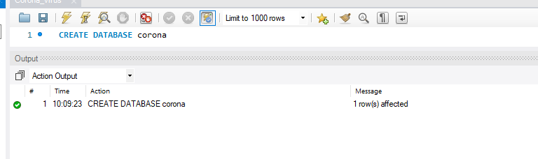
Data Exploration and Analysis
Database used for the Analysis
Database Set Up

Slide 6
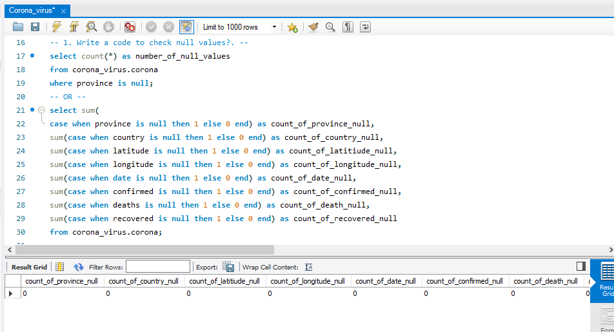
Data Cleaning
Q1. Write a code to check NULL values
Based on the result it could be rest assured that they are no NULL values present in our dataset

Slide 7
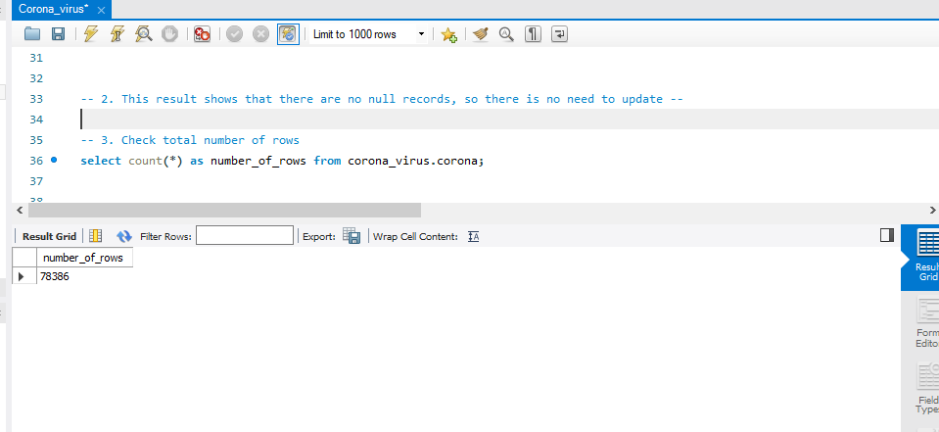
Q2. If NULL values are present update them with zero for each column
There were no NULL values present in the dataset
Q3. Check Total Number of Rows
The total number of records present in the Dataset is 79,386

Slide 8
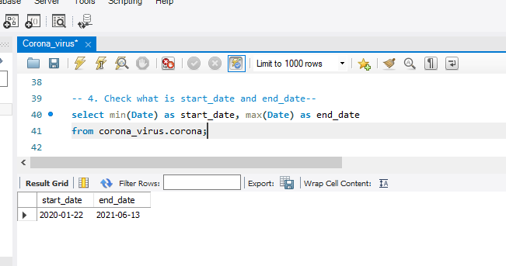
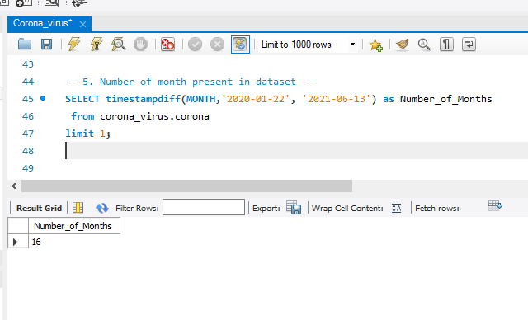
Q4. Check what is start date and end date
The dataset shows that record start on the 22nd of January 2020(2020-01-22) and ends on 13th June 2021(2021-06-13)
Q5. Number of month present in the dataset

Slide 9
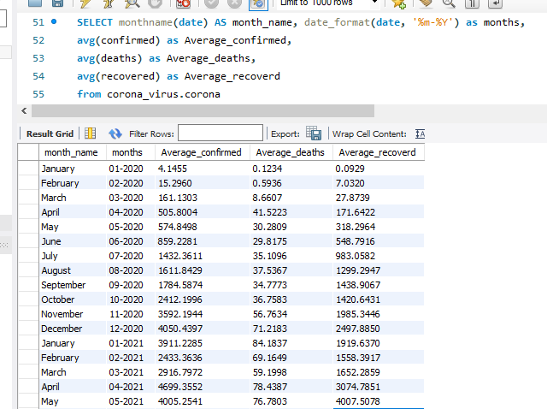
Q6. Find monthly average for confirmed, deaths and recovered

Slide 10
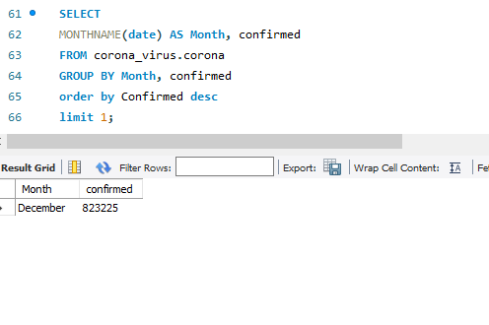
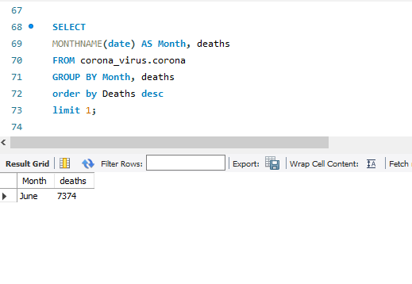
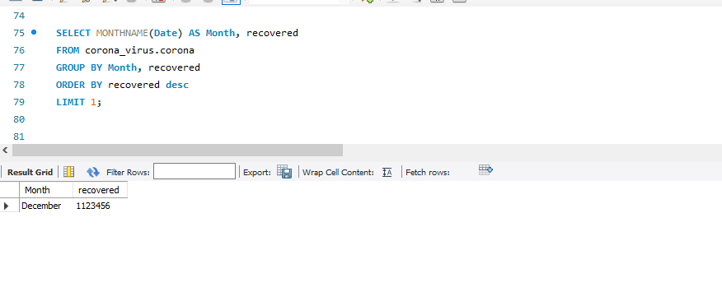
Q7. Find most frequent value for confirmed, deaths and recovered

Slide 11
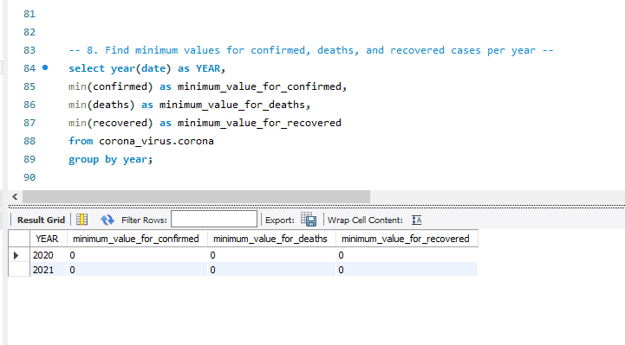
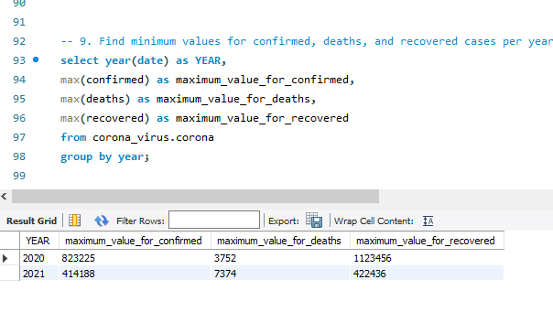
Q8. Find the minimum values for confirmed, deaths and recovered cases per year
Q9. Find the maximum values for confirmed, deaths and recovered cases per year

Slide 12
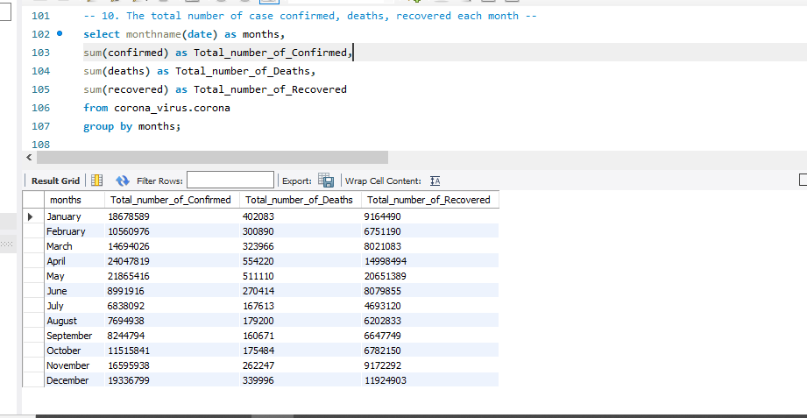

Q10. The total number of case confirmed deaths and recovered each months

Slide 13
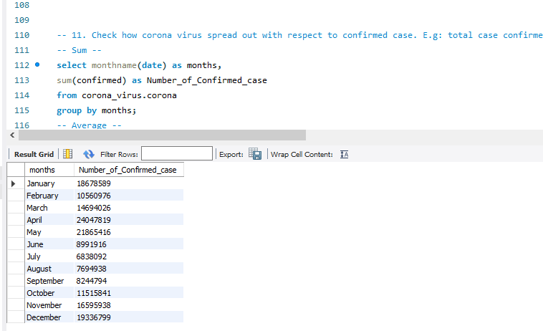
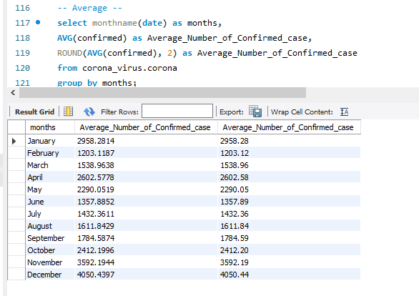
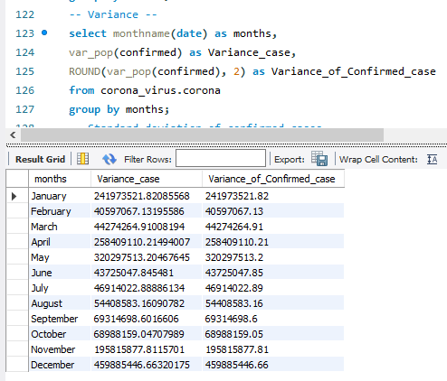
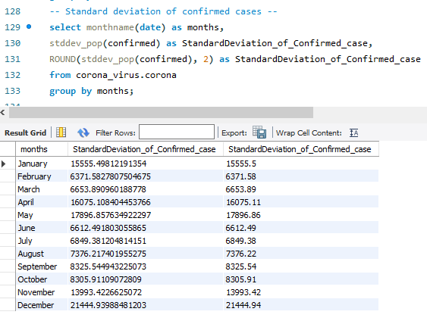
Q11. Check how corona virus spread out with respect to confirmed cases

Slide 14
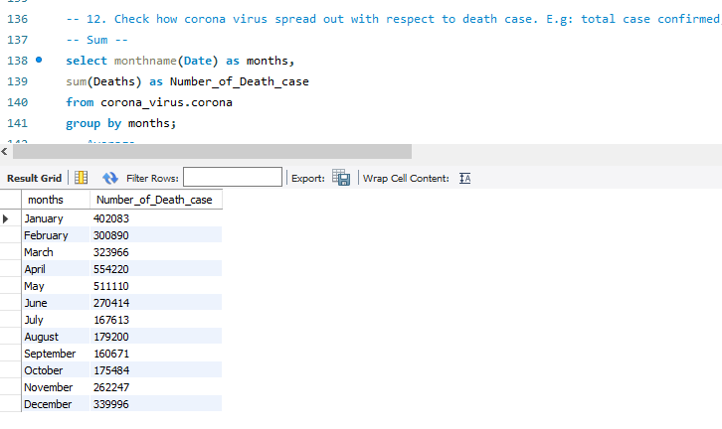
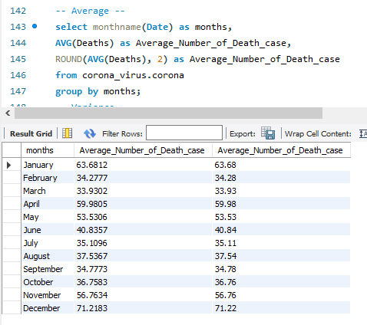
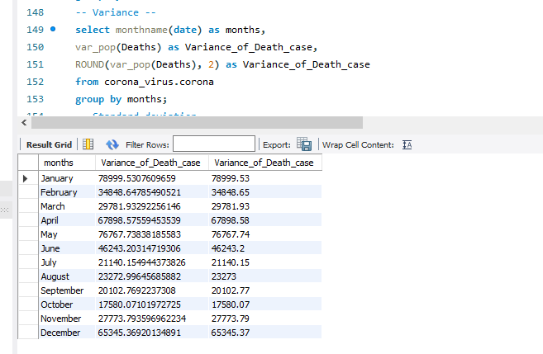
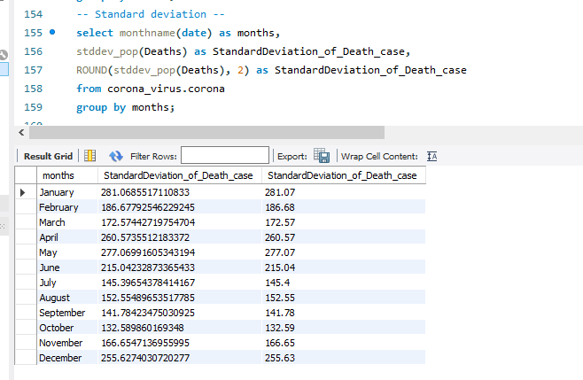
Q12. Check how corona virus spread out with respect to death cases

Slide 15
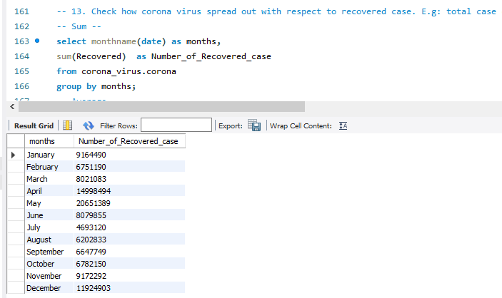
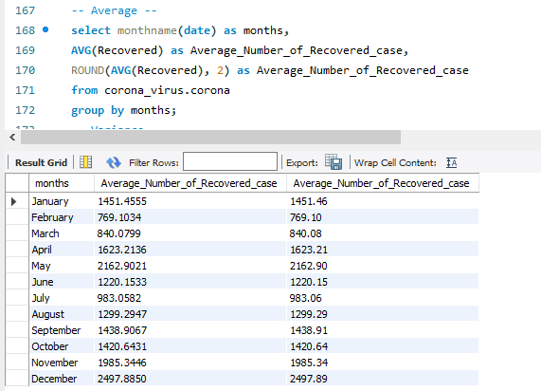
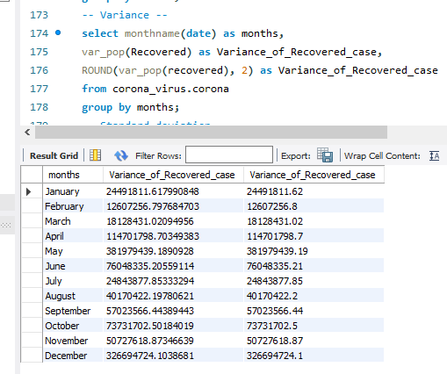
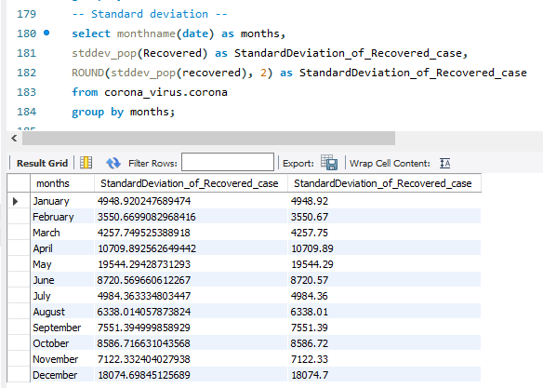
Q13. Check how corona virus spread out with respect to recovered cases

Slide 16
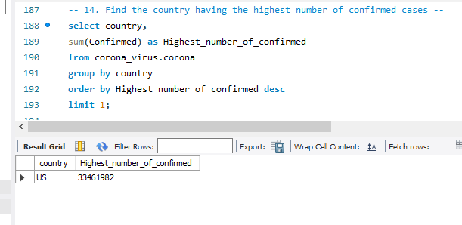
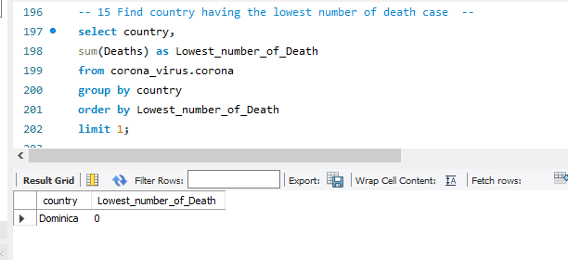
Q14. Find the country having highest number of confirmed cases
US have the highest number of confirmed cases which is 33,461,982
Q15. Find the country having the lowest number of death case
Dominica have the lowest number of death

Slide 17
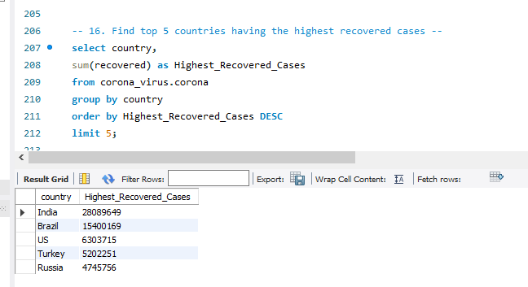
Q16. Find top 5 countries having the highest recovered cases
The Top 5 countries having the highest recovered cases are
India
Brazil
US
Turkey
Russia

Slide 18
INSIGHTS
After the detailed analysis of CORONA VIRUS dataset we can drew several conclusions
The dataset covers the period from January 22, 2020, to June 13, 2021.
The United States has the highest number of confirmed cases, totaling 33,461,982.
Dominica has the lowest number of death cases.
The top 5 countries with the highest number of recovered cases are:
India: 28,089,649
Brazil: 15,400,169
United States: 6,303,715
Turkey: 5,202,251
Russia: 4,745,756
These Analysis provide an insights of the COVID-19 situation in terms of confirmed cases, deaths, and recoveries across different countries during the specified time frame.

Slide 19


